Slide 1

MIDTERM PROJECT
DSCI-6007-01 TEAM-04
Dynamic Real-Time Insights from Reddit Data

Slide 2
CONTENTS
What is Reddit?
1
Solution
2
Problem Statement
3
Tools to be used
4
Crisp-dm Methodology
References
5
6
4
5
6
7

Slide 3

TEAM 4
Umair Moeen Tajmohammed
Team Leader & Data Scientist
Data Engineer
Sai Jitendra Chowdary Katragadda
Shanmukh Praveen Kothala
Data Analyst

Slide 4

REDDIT

Slide 5

PROBLEM
Identifying and detecting discriminatory comments on Reddit can be quite challenging. The platform faces hurdles in moderating content, promoting constructive conversations, and maintaining user anonymity. Issues like misinformation, hate speech, and uneven visibility across different communities complicate these efforts. Tackling these problems is crucial for fostering a safer and fairer environment.

Slide 6

SOLUTION
Improve user engagement while addressing harmful content and misinformation
Utilize machine learning algorithms to effectively detect and combat discriminatory comments.
Implement real-time monitoring on continuously updated data.

Slide 7
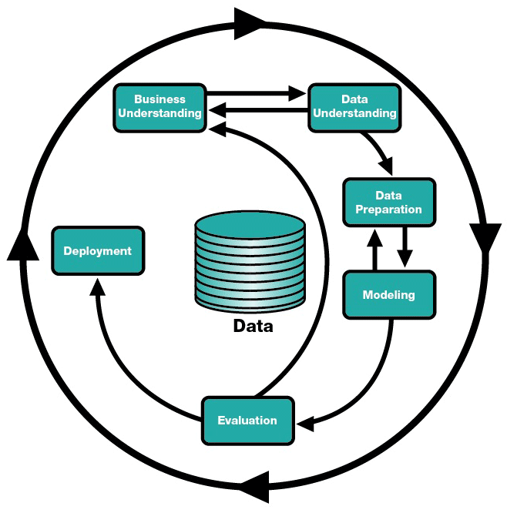
CRISP-DM METHODOLOGY
Business Understandin
Deployment
Data Preparation
Evalation
Modeling

Slide 8
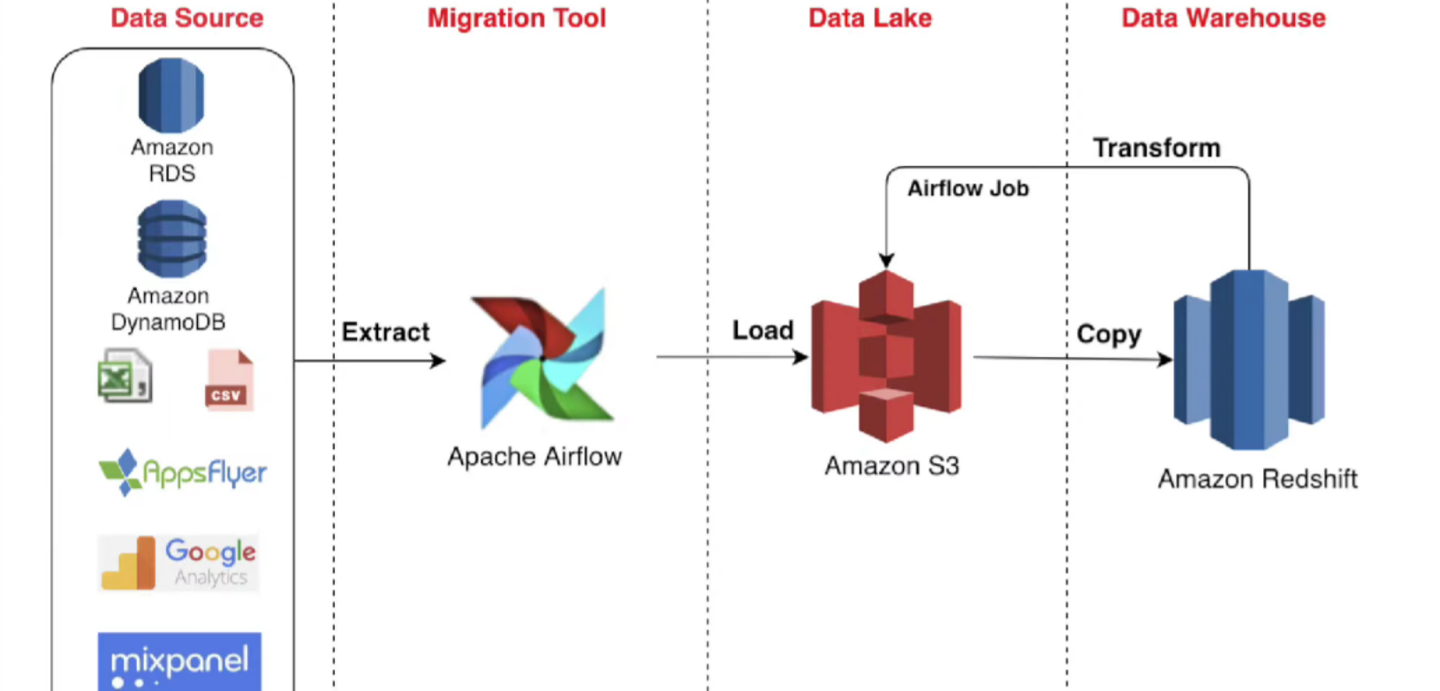
TOOLS

Slide 9
REFERENCES
GitHub Repo:
https://github.com/DSCI6007-01TEAM04/DSCI-6007-01-TEAM-04
https://www.youtube.com/watch?v=q8q3OFFfY6c&t=21

Slide 10


